Slide 1
Introduction
Drilling Fluid is circulated through the pipes in order to remove the grinded particles from the bottom of the well.
The fluid is pumped from the surface by a pump. The fluid then flows through the surface flowlines P_{s}.
Next, the fluid enters Pipe Conduits P1 and P2 and flows down towards the bottom.
Fluid then exits through Bit Nozzles P_{b} and flows upward to the surface through conduits P3 and P4.
Pump
Surface Flow Lines (Ps)
(P₁)
Pump Pressure (Pp)
(P4)
Recycled back to pump
(P₂)
(P3)
(P_{b})

Slide 2
Software Objective
Calculate Pressure Loss inside Pipes P1 and P2
Calculate Pressure Loss at Bit Nozzle P_{b}
Calculate Pressure Loss in Conduits P3 and P4
Calculate Pressure Loss at Surface Flowlines P_{s}
Determine Recommended Fluid Model

Slide 3
Mandatory Inputs
Well Data
Hole Size
Hole Depth
Casing Inner Diameter
Casing Depth
Drilling Fluid Parameters
Mud Weight
Viscometer Data
Pipe Data
Outer Diameter
Inner Diameter
Length
Flowrate
1. Flowrate
Bit Data
Nozzle Size
Number of Nozzles
Coefficient of Discharge

Slide 4
Required Outputs
The total Pressure Losses occurring in the system.
The total pressure loss is equated as the Pump Pressure ‘P_{p}’.
P_{p} = P_{s}+P1+P2+P_{b}+P3+P4
The total Pressure loss is the sum of the individual pressure loss listed below,
Surface Pressure Loss – P_{s}
Drillstring Pressure Loss – P1 and P2
Annular Pressure Loss – P3 and P4
Bit Pressure Loss – P_{b}

Slide 5
The Flow
Well Data
Input
Drilling Fluid Parameters
Bit Data
Pipe Data
Choose Fluid Model
Calculate Pressure Losses
Calculations
Pump Pressure
Output

Slide 6
Input Parameters

Slide 7
Well Data
Input
Hole Size (D_{h})
Hole Depth (MD_{h})
Casing Inner Diameter (D_{c})
Casing Depth (MD_{c})
A-1

Slide 8
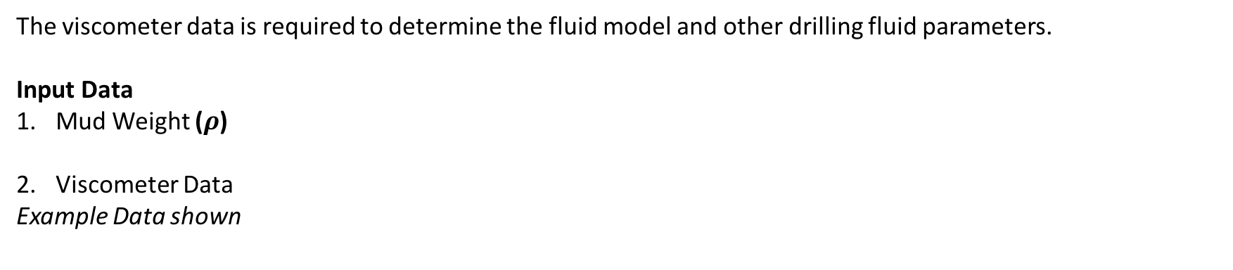
Drilling Fluid Parameters
The viscometer data is required to determine the fluid model and other drilling fluid parameters.
Input Data
Mud Weight ($ρ$)
Viscometer Data
Example Data shown
RPM | Dial
3 | 9
6 | 10
100 | 27
200 | 40
300 | 42
600 | 68
RPM – Display as Shown
Dial – User Entered
A-2

Slide 9
Pipe Data and Flowrate
Pipe Data
Three parameters are required as input.
Enter Pipe Dimensions
Pipe Outer Diameter (OD)
Pipe Inner Diameter (ID)
Pipe Length (L)
Flowrate
Flowrate (Q)
The pressure losses are dependent on the flowrate. It should be be the final input parameter before computation of pressure losses commences.
A-3

Slide 10
Bit Data
Inputs
Nozzle Size (D_{n})
Number of Nozzles
Coefficient of Discharge (C_{d})
A-4

Slide 11
Calculations

Slide 12
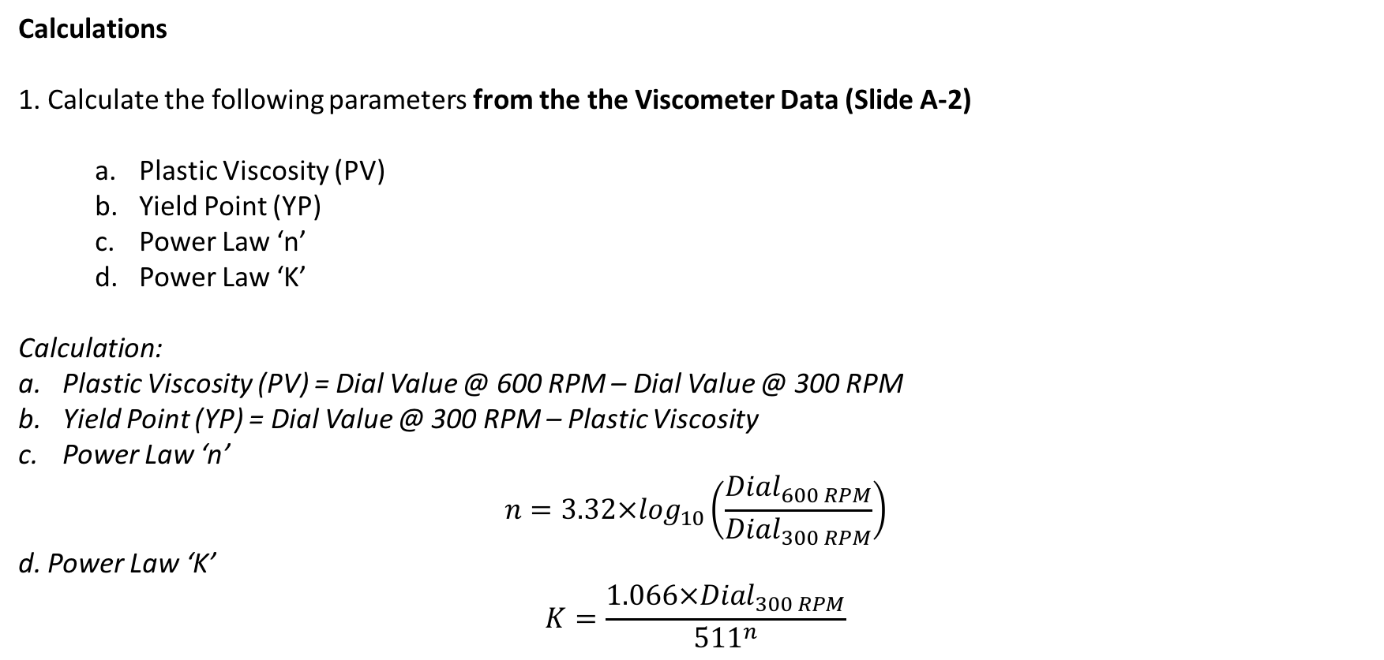
Drilling Fluid Parameters
Calculations
1. Calculate the following parameters from the the Viscometer Data (Slide A-2)
Plastic Viscosity (PV)
Yield Point (YP)
Power Law ‘n’
Power Law ‘K’
Calculation:
Plastic Viscosity (PV) = Dial Value @ 600 RPM – Dial Value @ 300 RPM
Yield Point (YP) = Dial Value @ 300 RPM – Plastic Viscosity
Power Law ‘n’
$$n=3.32×\log_{10}\left(\frac{{Dial}_{600 RPM}}{{Dial}_{300 RPM}}\right)$$
d. Power Law ‘K’
$$K=\frac{1.066×{Dial}_{300 RPM}}{{511}^{n}}$$
B-1

Slide 13
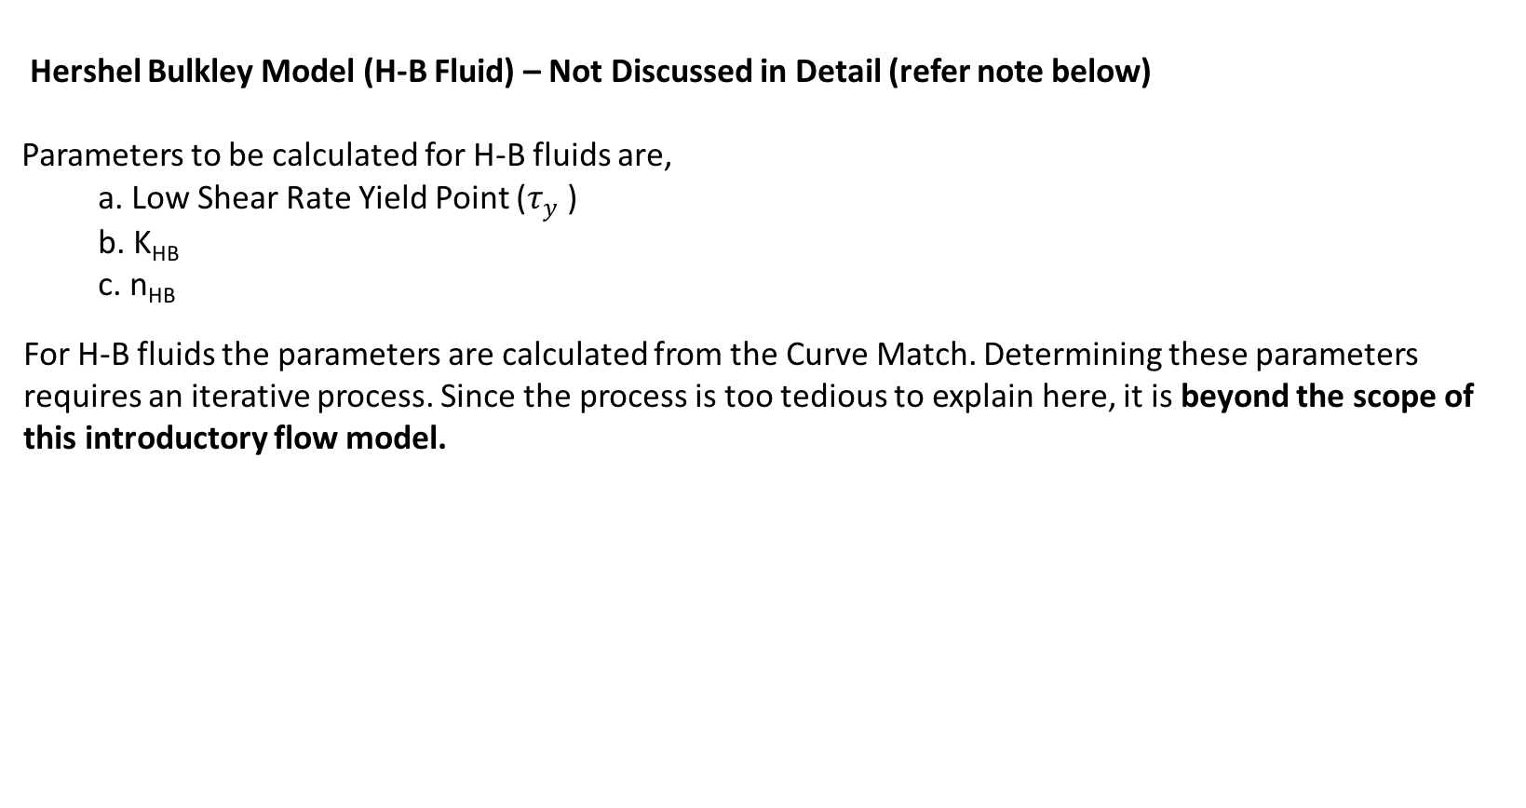
Drilling Fluid Parameters
Hershel Bulkley Model (H-B Fluid) – Not Discussed in Detail (refer note below)
Parameters to be calculated for H-B fluids are,
a. Low Shear Rate Yield Point ($τ_{y}$ )
b. K_{HB}
c. n_{HB}
For H-B fluids the parameters are calculated from the Curve Match. Determining these parameters requires an iterative process. Since the process is too tedious to explain here, it is beyond the scope of this introductory flow model.
B-2

Slide 14
Determining Fluid Model
2. Determine Best Fit Fluid Model. Compare between the following Models
Bingham Plastic
Power Law
Hershel Bulkley
A curve is plotted for each of these models and then the deviation from the Viscometer Data is calculated.
The model which has the least deviation will be the recommended Fluid Model.
For introductory purposes, the curve match procedure is not discussed here.
For the basic model, make the choice of fluid model manual and user entered.
B-3

Slide 15
Calculating Pressure Losses
The equations to calculate pressure loss is different for each fluid model.
Procedure for Pressure Loss Calculations:
Step 1:Enter Flowrate (Q) and calculate flow velocity (V)
Step 2: Calculate Pressure Loss at Bit P_{b}
Step 3: Calculate Pressure Losses P_{s} , P1 and P2
Step 4: Calculate Pressure Losses P3 and P4
Step5: Calculate Pump Pressure P_{p}
Pump Pressure is the sum of all the pressure losses.
P_{p} = P_{s}+P1+P2+P_{b}+P3+P4
Each pressure losses have to be individually calculated and then finally summed up to get the pump pressure.
B-4

Slide 16

Calculating Pressure Losses
Stepwise Procedure to calculate pressure losses
Step 1: Calculate Flow Velocity (V)
$$V=\frac{24.51×Q}{{ID}^{2}}$$
Q – Flowrate – Slide A-3
ID – Pipe Inner Diameter – Slide A-3
B-5

Slide 17

Calculating Pressure Losses
Step 2 - Calculating Pressure Loss at Bit
1: Calculate Total Flow Area:
$$TFA=\frac{No of Nozzles}{4}×π×{\left(\frac{Nozzle Size}{32}\right)}^{2}$$
2. Pressure loss at bit:
$$P_{b}=\frac{ρ×Q}{12042×{C_{d}}^{2}×{TFA}^{2}}$$
$ρ$ - Mud Weight – Slide A-2
Q – Flowrate – Slide A-3
C_{d} – Coefficient of Discharge – Slide A-4
No of Nozzles – Slide A-4
Nozzle Size – Slide A-4
B-6

Slide 18
Calculating Pressure Losses
Step 3 - Calculating Pressure Losses P_{s}, P1 and P2
Check for fluid model chosen by user (Slide B-3)
Use relevant calculating procedure based on fluid model.
User will choose any one out of the three fluid models (Slide B-3).
For introductory purposes, only Bingham Plastic Model and Power Law model equations are described here.
Bingham Plastic Model procedure is described from Slide B-8 to Slide B-9
Power Law Model procedure is described from Slide B-10 to Slide B-14
Step 4 – Calculating Pressure Losses P3 and P4
Calculation procedure is the same as that for P_{s}, P1 and P2. The equations have slight variation and for introductory purposes the equations are not shown in this flow. No need to calculate for the basic model.
Step 5 – Calculate Pump Pressure
Pump pressure is the sum of all the pressure losses P_{s}, P1, P2, P3, P4 and P_{b}. (Slide B-4)
B-7

Slide 19
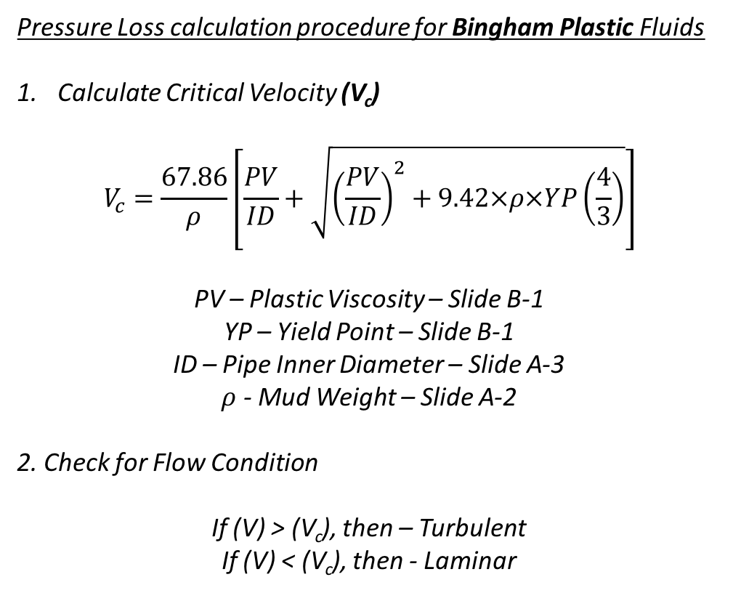
Calculating Pressure Losses
Pressure Loss calculation procedure for Bingham Plastic Fluids
Calculate Critical Velocity (V_{c})
$$V_{c}=\frac{67.86}{ρ}\left[\frac{PV}{ID}+\sqrt{{\left(\frac{PV}{ID}\right)}^{2}+9.42×ρ×YP\left(\frac{4}{3}\right)}\right]$$
PV – Plastic Viscosity – Slide B-1
YP – Yield Point – Slide B-1
ID – Pipe Inner Diameter – Slide A-3
$ρ$ - Mud Weight – Slide A-2
2. Check for Flow Condition
If (V) > (V_{c}), then – Turbulent
If (V) < (V_{c}), then - Laminar
B-8

Slide 20
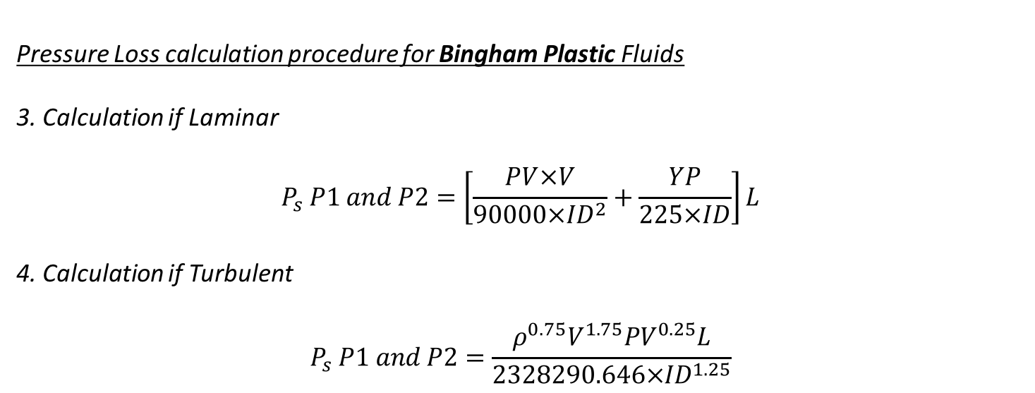
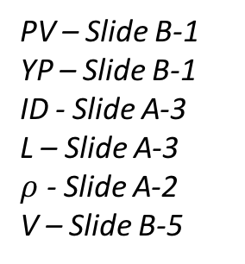
Calculating Pressure Losses
Pressure Loss calculation procedure for Bingham Plastic Fluids
3. Calculation if Laminar
$$P_{s} P1 and P2=\left[\frac{PV×V}{90000×{ID}^{2}}+\frac{YP}{225×ID}\right]L$$
4. Calculation if Turbulent
$$P_{s} P1 and P2=\frac{ρ^{0.75}V^{1.75}{PV}^{0.25}L}{2328290.646×{ID}^{1.25}}$$
PV – Slide B-1
YP – Slide B-1
ID - Slide A-3
L – Slide A-3
$ρ$ - Slide A-2
V – Slide B-5
End of Procedure for Bingham Plastic Fluids
B-9

Slide 21
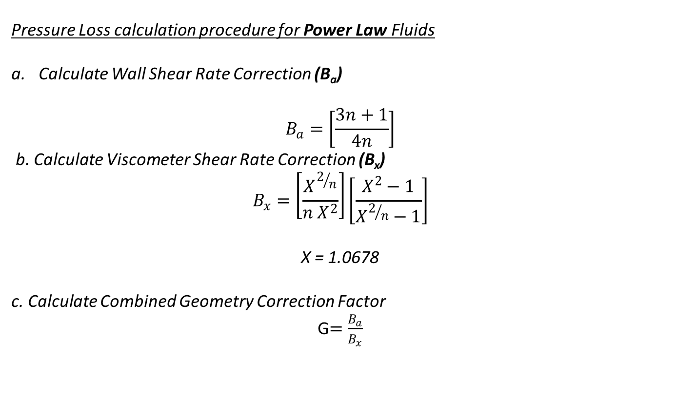
Calculating Pressure Losses
Calculating Pressure Losses P_{s} , P1 and P2 - Power Law Fluid
Pressure Loss calculation procedure for Power Law Fluids
Calculate Wall Shear Rate Correction (B_{a})
$$B_{a}=\left[\frac{3n+1}{4n}\right]$$
b. Calculate Viscometer Shear Rate Correction (B_{x})
$$B_{x}=\left[\frac{X^{2/n}}{n X^{2}}\right]\left[\frac{X^{2}−1}{X^{2/n}−1}\right]$$
X = 1.0678
c. Calculate Combined Geometry Correction Factor
G$=\frac{B_{a}}{B_{x}}$
n – Slide B-1
B-10

Slide 22

Calculating Pressure Losses
Calculating Pressure Losses P_{s} , P1 and P2 - Power Law Fluid
Pressure Loss calculation procedure for Power Law Fluids
d. Calculate Shear Rate at Wall ($γ_{w}$)
$$γ_{w}=\frac{1.6 G V}{ID}$$
e. Calculate Shear Stress at the Wall ($τ_{w}$)
$$τ_{w}=1.066×K{γ_{w}}^{n}$$
V – Flow Velocity - Slide B-5
ID – Pipe Inner Diameter - Slide A-3
K – Slide B-1
n – Slide B-1
G – Slide B-10
B-11

Slide 23
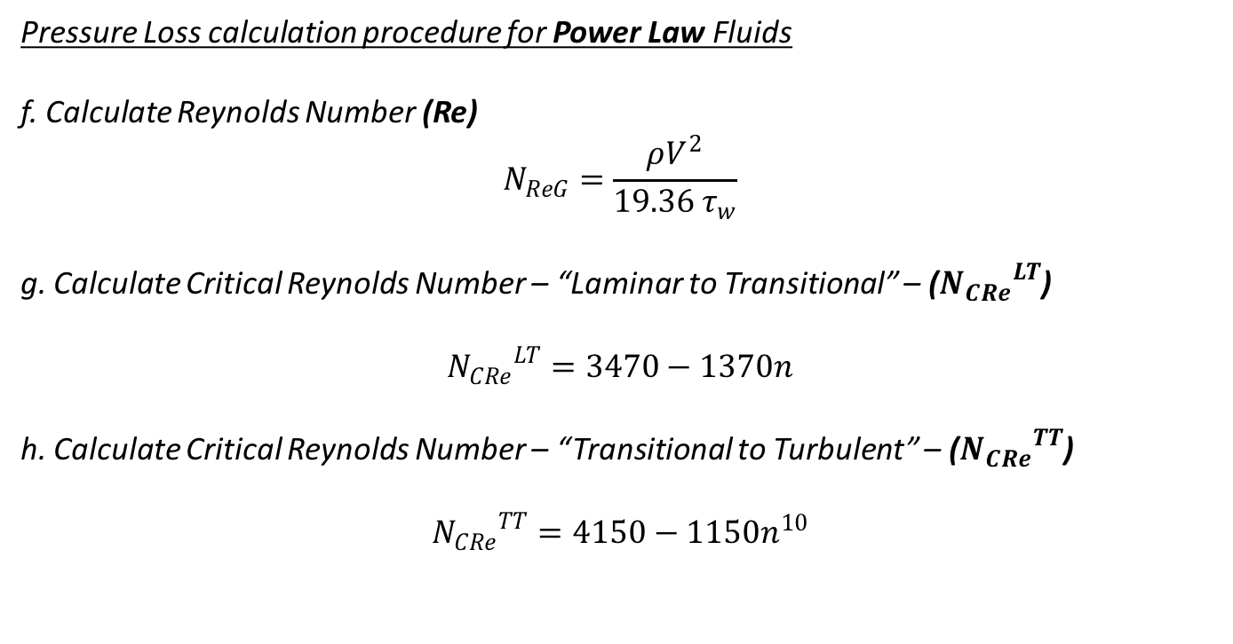
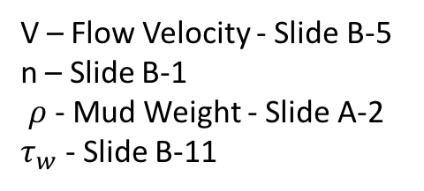
Calculating Pressure Losses
Calculating Pressure Losses P_{s} , P1 and P2 - Power Law Fluid
Pressure Loss calculation procedure for Power Law Fluids
f. Calculate Reynolds Number (Re)
$$N_{ReG}=\frac{ρV^{2}}{19.36 τ_{w}}$$
g. Calculate Critical Reynolds Number – “Laminar to Transitional” – (${N_{CRe}}^{LT}$)
$${N_{CRe}}^{LT}=3470−1370n$$
h. Calculate Critical Reynolds Number – “Transitional to Turbulent” – (${N_{CRe}}^{TT}$)
$${N_{CRe}}^{TT}=4150−1150n^{10}$$
V – Flow Velocity - Slide B-5
n – Slide B-1
$ρ$ - Mud Weight - Slide A-2
$τ_{w}$ - Slide B-11
B-12

Slide 24
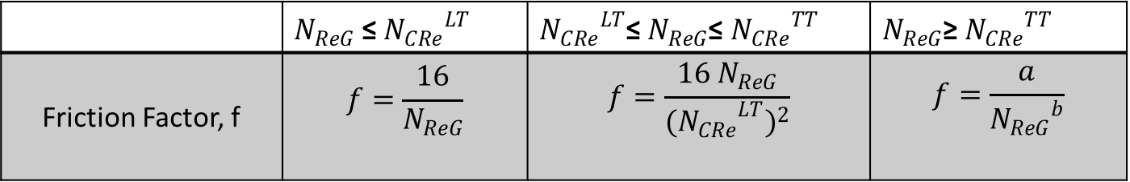

Calculating Pressure Losses
Calculating Pressure Losses P_{s} , P1 and P2 - Power Law Fluid
Pressure Loss calculation procedure for Power Law Fluids
i. Determine Friction Factor (f). Check for condition as shown,
n – Slide B-1
 | $N_{ReG}$ ≤ ${N_{CRe}}^{LT}$ | ${N_{CRe}}^{LT}$≤ $N_{ReG}$≤ ${N_{CRe}}^{TT}$ | $N_{ReG}$≥ ${N_{CRe}}^{TT}$
Friction Factor, f | $$f=\frac{16}{N_{ReG}}$$ | $$f=\frac{16 N_{ReG}}{{{{(N}_{CRe}}^{LT})}^{2}}$$ | $$f=\frac{a}{{N_{ReG}}^{b}}$$
$$a=\frac{\log_{10}\left(n\right)+3.93}{50}$$
$$b=\frac{1.75−\log_{10}\left(n\right)}{7}$$
B-13

Slide 25
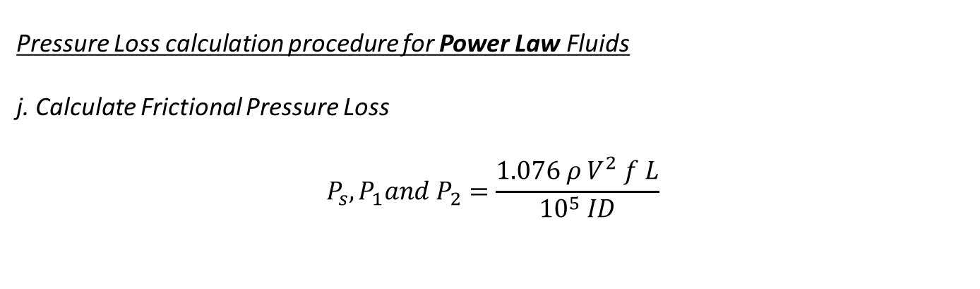
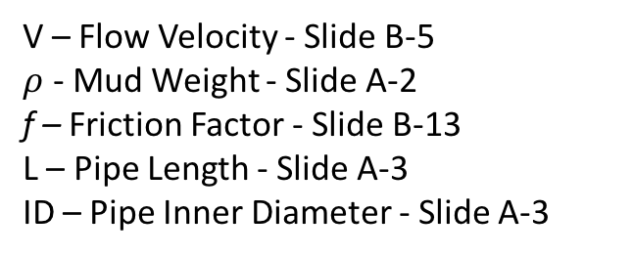
Calculating Pressure Losses
Calculating Pressure Losses P_{s} , P1 and P2 - Power Law Fluid
Pressure Loss calculation procedure for Power Law Fluids
j. Calculate Frictional Pressure Loss
$$P_{s},P_{1}and{ P}_{2}=\frac{1.076 ρ V^{2} f L}{{10}^{5} ID}$$
V – Flow Velocity - Slide B-5
$ρ$ - Mud Weight - Slide A-2
f – Friction Factor - Slide B-13
L – Pipe Length - Slide A-3
ID – Pipe Inner Diameter - Slide A-3
End of Procedure for Power Law fluid model
B-14

Slide 26
Output

Slide 27
Output Displayed
Inputs to be displayed in Output
Well Data
Hole Size (Slide A-1)
Hole Depth (Slide A-1)
Casing Inner Diameter (Slide A-1)
Casing Depth (Slide A-1)
2. Drilling Fluid Parameters
Mud Weight (Slide A-2)
3. Pipe Data
Pipe Outer Diameter (Slide A-3)
Pipe Inner Diameter (Slide A-3)
Pipe Length (Slide A-3)
4. Flowrate (Slide A-3)
5. Bit Data
Nozzle Size (Slide A-4)
Number of Nozzles (Slide A-4)
C-1

Slide 28
Output Displayed
Calculated values to be displayed in Output
Drilling Fluid Parameters
Plastic Viscosity (Slide B-1)
Yield Point (Slide B-1)
Power Law ‘n’ (Slide B-1)
Power Law ‘K’ (Slide B-1)
2. Fluid Model Chosen (Slide B-3)
3. Pressure Losses P_{s}, P1, P2, P3 and P4 (Slide B-7)
4. Pressure Loss at Bit P_{b} (Slide B-6)
5. Pump Pressure P_{p}. (Slide B-4)
C-2

